Slide 1




Chapter 5: Support Vector Machines
MACHINE LEARNING

Slide 2
Introduction to SVMs
Definition:
SVMs are supervised learning models used for classification and regression tasks.
Key Idea:
Find the hyperplane that best separates classes in the feature space.
Applications:
Text classification, image recognition, bioinformatics.​
Notes:
When conducting research, it is easy to go to one source: Wikipedia. However, you need to include a variety of sources in your research. Consider the following sources:
Who can I interview to get more information on the topic?
Is the topic current and will it be relevant to my audience?
What articles, blogs, and magazines may have something related to my topic?
Is there a YouTube video on the topic? If so, what is it about?
What images can I find related to the topic?

Slide 3
Linear SVM Classification
Use Case: When data is linearly separable.
Function: Finds a straight-line (or hyperplane in higher dimensions) to separate classes.
Example: Binary classification with clearly separable classes.
Notes:
When conducting research, it is easy to go to one source: Wikipedia. However, you need to include a variety of sources in your research. Consider the following sources:
Who can I interview to get more information on the topic?
Is the topic current and will it be relevant to my audience?
What articles, blogs, and magazines may have something related to my topic?
Is there a YouTube video on the topic? If so, what is it about?
What images can I find related to the topic?

Slide 4
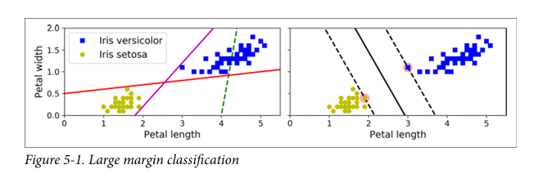
Visualizing Linear Classification
Three Classifiers on Iris Dataset:
Thin Solid Line Classifiers: Correct, but margins are narrow → may not generalize well.
Dashed Line Classifier: Incorrect – fails to separate the classes.
Bold Solid Line (SVM): Maximizes margin → better generalization.
Large Margin Classification: SVM chooses the hyperplane that leaves the widest margin between the two classes.
Notes:
When conducting research, it is easy to go to one source: Wikipedia. However, you need to include a variety of sources in your research. Consider the following sources:
Who can I interview to get more information on the topic?
Is the topic current and will it be relevant to my audience?
What articles, blogs, and magazines may have something related to my topic?
Is there a YouTube video on the topic? If so, what is it about?
What images can I find related to the topic?

Slide 5
Visualizing Linear Classification
Support Vectors:
Data points lying directly on the edges of the margin (the dashed lines).
Key Property: These are the only data points that influence the decision boundary.
Effect of More Data: Adding instances away from the street does not affect the SVM boundary.
Notes:
When conducting research, it is easy to go to one source: Wikipedia. However, you need to include a variety of sources in your research. Consider the following sources:
Who can I interview to get more information on the topic?
Is the topic current and will it be relevant to my audience?
What articles, blogs, and magazines may have something related to my topic?
Is there a YouTube video on the topic? If so, what is it about?
What images can I find related to the topic?

Slide 6
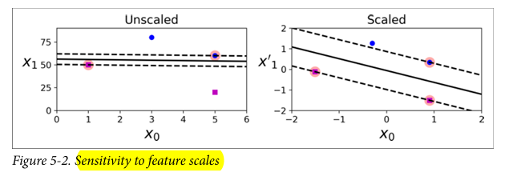
Sensitivity to Feature Scales
Left Plot:
Features have different scales → SVM creates a skewed decision boundary.
Vertical axis dominates due to larger scale.
Right Plot (After Feature Scaling):
Proper scaling (e.g., using StandardScaler) results in a balanced and accurate decision boundary.
So Always apply feature scaling (e.g., standardization) before training an SVM model.
Notes:
When conducting research, it is easy to go to one source: Wikipedia. However, you need to include a variety of sources in your research. Consider the following sources:
Who can I interview to get more information on the topic?
Is the topic current and will it be relevant to my audience?
What articles, blogs, and magazines may have something related to my topic?
Is there a YouTube video on the topic? If so, what is it about?
What images can I find related to the topic?

Slide 7

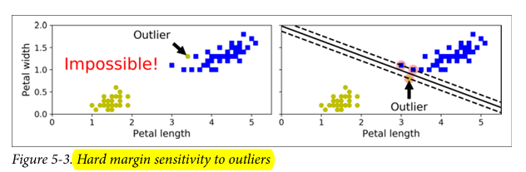
Soft Margin Classification
Hard Margin Issues:
Requires perfectly linearly separable data
Extremely sensitive to outliers
One outlier can destroy the decision boundary
Notes:
Once you find your sources, you will want to evaluate your sources using the following questions:
Author:
Who is the author?
Why should I believe what he or she has to say on the topic?
Is the author seen as an expert on the topic? How do you know?
Current:
How current is the information in the source?
When was the source published?
Is the information out-of-date?
Accuracy:
Is the content accurate?
Is the information presented objectively? Do they share the pros and cons?

Slide 8
Visualizing the Problem
❌No possible boundary due to outlier
❌ Bad decision boundary due to forced separation
Takeaway:
Hard Margin = Overly rigid
Soft Margin = Flexible, better for real-world data
Notes:
Once you find your sources, you will want to evaluate your sources using the following questions:
Author:
Who is the author?
Why should I believe what he or she has to say on the topic?
Is the author seen as an expert on the topic? How do you know?
Current:
How current is the information in the source?
When was the source published?
Is the information out-of-date?
Accuracy:
Is the content accurate?
Is the information presented objectively? Do they share the pros and cons?

Slide 9
Soft Margin Classification
Soft Margin Classification:
Allows some margin violations to improve generalization
Goal: Balance between wide margin and few violations
The Role of Hyperparameter C:
C controls trade-off between:
Margin size
Margin violations
Notes:
Once you find your sources, you will want to evaluate your sources using the following questions:
Author:
Who is the author?
Why should I believe what he or she has to say on the topic?
Is the author seen as an expert on the topic? How do you know?
Current:
How current is the information in the source?
When was the source published?
Is the information out-of-date?
Accuracy:
Is the content accurate?
Is the information presented objectively? Do they share the pros and cons?

Slide 10
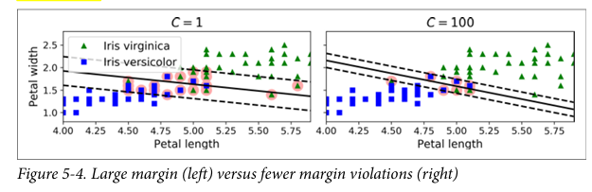
Role of Hyperparameter C
Low C:
More violations allowed
Wider margin → Better generalization
High C:
Fewer violations
Narrower margin → Higher risk of overfitting
Reduce C to regularize an overfitting SVM
Notes:
Once you find your sources, you will want to evaluate your sources using the following questions:
Author:
Who is the author?
Why should I believe what he or she has to say on the topic?
Is the author seen as an expert on the topic? How do you know?
Current:
How current is the information in the source?
When was the source published?
Is the information out-of-date?
Accuracy:
Is the content accurate?
Is the information presented objectively? Do they share the pros and cons?

Slide 11
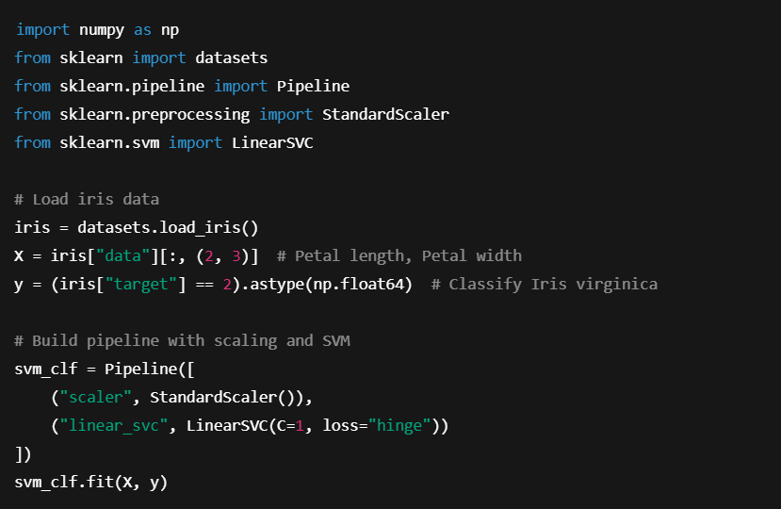
Code Example:
Note: SVM classifiers do not output probabilities
Use decision_function() to get distance from decision boundary.
Notes:
Once you find your sources, you will want to evaluate your sources using the following questions:
Author:
Who is the author?
Why should I believe what he or she has to say on the topic?
Is the author seen as an expert on the topic? How do you know?
Current:
How current is the information in the source?
When was the source published?
Is the information out-of-date?
Accuracy:
Is the content accurate?
Is the information presented objectively? Do they share the pros and cons?

Slide 12
Alternative SVM Implementations
Classifier | Notes
LinearSVC | Fast, recommended for large datasets
SVC(kernel="linear") | Slower, but supports probability outputs with probability=True
SGDClassifier | Good for online learning or huge datasets
Notes:
Once you find your sources, you will want to evaluate your sources using the following questions:
Author:
Who is the author?
Why should I believe what he or she has to say on the topic?
Is the author seen as an expert on the topic? How do you know?
Current:
How current is the information in the source?
When was the source published?
Is the information out-of-date?
Accuracy:
Is the content accurate?
Is the information presented objectively? Do they share the pros and cons?

Slide 13
Practical Tips & Reminders
✅ Use StandardScaler to center and scale data
✅ Set loss="hinge" in LinearSVC
✅ Set dual=False if features > training examples
✅ Tune C for regularization and margin control
Notes:
Once you find your sources, you will want to evaluate your sources using the following questions:
Author:
Who is the author?
Why should I believe what he or she has to say on the topic?
Is the author seen as an expert on the topic? How do you know?
Current:
How current is the information in the source?
When was the source published?
Is the information out-of-date?
Accuracy:
Is the content accurate?
Is the information presented objectively? Do they share the pros and cons?

Slide 14
Nonlinear SVM Classification
Many real-world datasets are not linearly separable.
Linear SVMs struggle with complex data distributions.
We need a way to transform data for linear separation.
One approach to handling nonlinear datasets is to add more features, such as polynomial features (as you did in Chapter 4)
Notes:
After consulting a variety of sources, you will need to narrow your topic. For example, the topic of internet safety is huge, but you could narrow that topic to include internet safety in regards to social media apps that teenagers are using heavily. A topic like that is more specific and will be relevant to your peers. Some questions to think about to help you narrow your topic:
What topics of the research interest me the most?
What topics of the research will interest my audience the most?
What topics will the audience find more engaging? Shocking? Inspiring?

Slide 15
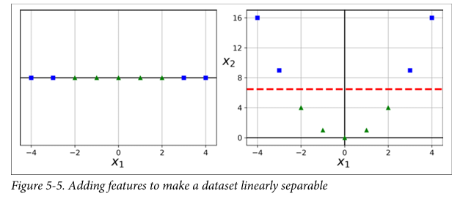
Nonlinear SVM Classification
Left: it represents a simple dataset with just one feature, x1 . This dataset is not linearly separable
Right: if you add a second feature x2 = (x1 )2, the resulting 2D dataset is perfectly linearly separable
Notes:
After consulting a variety of sources, you will need to narrow your topic. For example, the topic of internet safety is huge, but you could narrow that topic to include internet safety in regards to social media apps that teenagers are using heavily. A topic like that is more specific and will be relevant to your peers. Some questions to think about to help you narrow your topic:
What topics of the research interest me the most?
What topics of the research will interest my audience the most?
What topics will the audience find more engaging? Shocking? Inspiring?

Slide 16
Nonlinear SVM Classification
Adding Polynomial Features:
Example:1D feature x1 → Not separable.
Add x2 = (x1)^2 → Becomes separable in 2D.
Technique:
Use Polynomial Features to expand the feature space.
Combine with Standard Scaler and Linear SVC.
Notes:
After consulting a variety of sources, you will need to narrow your topic. For example, the topic of internet safety is huge, but you could narrow that topic to include internet safety in regards to social media apps that teenagers are using heavily. A topic like that is more specific and will be relevant to your peers. Some questions to think about to help you narrow your topic:
What topics of the research interest me the most?
What topics of the research will interest my audience the most?
What topics will the audience find more engaging? Shocking? Inspiring?

Slide 17
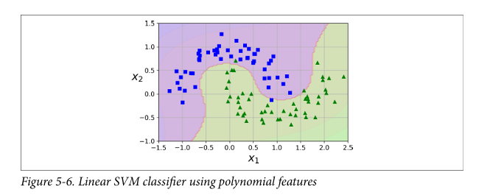
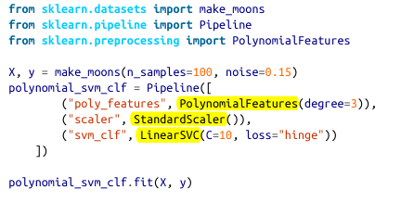
Nonlinear SVM Classification
Adding Polynomial Features:
Notes:
After consulting a variety of sources, you will need to narrow your topic. For example, the topic of internet safety is huge, but you could narrow that topic to include internet safety in regards to social media apps that teenagers are using heavily. A topic like that is more specific and will be relevant to your peers. Some questions to think about to help you narrow your topic:
What topics of the research interest me the most?
What topics of the research will interest my audience the most?
What topics will the audience find more engaging? Shocking? Inspiring?

Slide 18
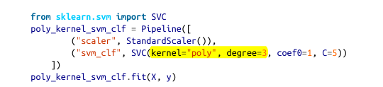
Polynomial Kernel
Adding polynomial features can be inefficient.
The kernel trick computes high-dimensional feature space without explicitly adding features.
SVC(kernel="poly", degree=3) does this efficiently.
Works similarly to added features but faster and scalable.
Notes:
After consulting a variety of sources, you will need to narrow your topic. For example, the topic of internet safety is huge, but you could narrow that topic to include internet safety in regards to social media apps that teenagers are using heavily. A topic like that is more specific and will be relevant to your peers. Some questions to think about to help you narrow your topic:
What topics of the research interest me the most?
What topics of the research will interest my audience the most?
What topics will the audience find more engaging? Shocking? Inspiring?

Slide 19
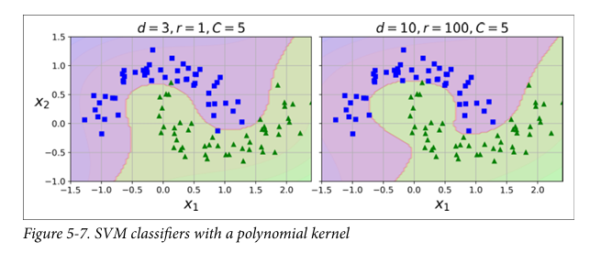
Polynomial Kernel
This code trains an SVM classifier using a third-degree polynomial kernel. It is represented in Figure 5-7
Note:
The hyperparameter coef0 controls how much the model is influenced by high degree polynomials versus low-degree polynomials
if your model is overfitting, you might want to reduce the polynomial degree. Conversely, if it is underfitting, you can try increasing it.
Notes:
After consulting a variety of sources, you will need to narrow your topic. For example, the topic of internet safety is huge, but you could narrow that topic to include internet safety in regards to social media apps that teenagers are using heavily. A topic like that is more specific and will be relevant to your peers. Some questions to think about to help you narrow your topic:
What topics of the research interest me the most?
What topics of the research will interest my audience the most?
What topics will the audience find more engaging? Shocking? Inspiring?

Slide 20

Similarity Feature
Use Gaussian RBF to measure similarity with landmarks
Feature transformation:
Adds nonlinearity and locality.
This is a bell-shaped function varying from 0 (very far away from the landmark) to 1 (at the landmark). Now we are ready to compute the new features.
For example, let’s look at the instance x1 = –1: it is located at a distance of 1 from the first landmark and 2 from the second landmark. Therefore its new features are:
x2= exp(–0.3 × 12) ≈ 0.74
and
x3 = exp(–0.3 × 22) ≈ 0.30.
Notes:
After consulting a variety of sources, you will need to narrow your topic. For example, the topic of internet safety is huge, but you could narrow that topic to include internet safety in regards to social media apps that teenagers are using heavily. A topic like that is more specific and will be relevant to your peers. Some questions to think about to help you narrow your topic:
What topics of the research interest me the most?
What topics of the research will interest my audience the most?
What topics will the audience find more engaging? Shocking? Inspiring?

Slide 21
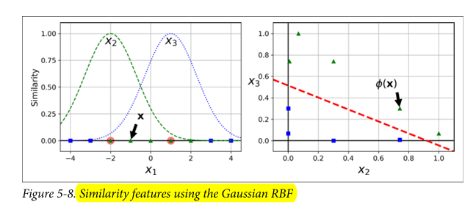
Similarity Feature
Explained further in figure 5.8
Taking the 1D dataset discussed earlier and add two landmarks to it at x1 = –2 and x1= 1
Increasing gamma makes the bell-shaped curve narrower
The transformed dataset (dropping the original features).As you can see, it is now linearly separable.
Notes:
After consulting a variety of sources, you will need to narrow your topic. For example, the topic of internet safety is huge, but you could narrow that topic to include internet safety in regards to social media apps that teenagers are using heavily. A topic like that is more specific and will be relevant to your peers. Some questions to think about to help you narrow your topic:
What topics of the research interest me the most?
What topics of the research will interest my audience the most?
What topics will the audience find more engaging? Shocking? Inspiring?

Slide 22
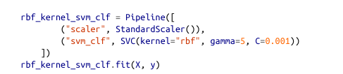
Gaussian RBF Kernel
Applies kernel trick with RBF function.
No need to compute all similarity features manually.
This model is represented in Figure 5-9
Notes:
After consulting a variety of sources, you will need to narrow your topic. For example, the topic of internet safety is huge, but you could narrow that topic to include internet safety in regards to social media apps that teenagers are using heavily. A topic like that is more specific and will be relevant to your peers. Some questions to think about to help you narrow your topic:
What topics of the research interest me the most?
What topics of the research will interest my audience the most?
What topics will the audience find more engaging? Shocking? Inspiring?

Slide 23
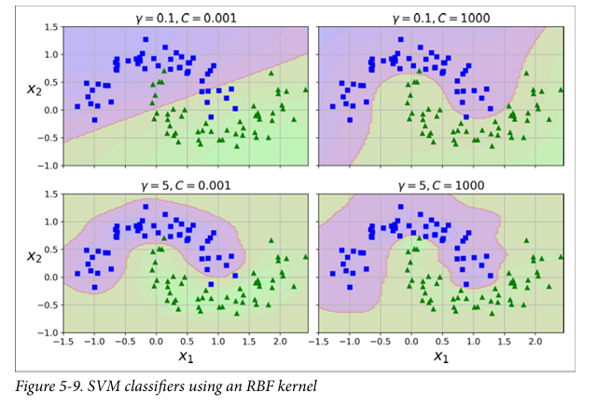
Gaussian RBF Kernel
The other plots show models trained with different values of hyperparameters gamma (γ) and C
Explained further in figure 5.9
Gamma (γ) acts like a regularization hyperparameter:
if your model is overfitting, you should reduce it; if it is underfitting, you should increase it (similar to the C hyperparameter).
Notes:
After consulting a variety of sources, you will need to narrow your topic. For example, the topic of internet safety is huge, but you could narrow that topic to include internet safety in regards to social media apps that teenagers are using heavily. A topic like that is more specific and will be relevant to your peers. Some questions to think about to help you narrow your topic:
What topics of the research interest me the most?
What topics of the research will interest my audience the most?
What topics will the audience find more engaging? Shocking? Inspiring?

Slide 24
Choosing the Right Kernel
kernel | For what?
Linear kernel: | First choice for large feature spaces.
RBF kernel: | Versatile, performs well in most cases.
Polynomial kernel: | Try for moderate complexity data.
GridSearchCV | to fine-tune hyperparameters.
Notes:
After consulting a variety of sources, you will need to narrow your topic. For example, the topic of internet safety is huge, but you could narrow that topic to include internet safety in regards to social media apps that teenagers are using heavily. A topic like that is more specific and will be relevant to your peers. Some questions to think about to help you narrow your topic:
What topics of the research interest me the most?
What topics of the research will interest my audience the most?
What topics will the audience find more engaging? Shocking? Inspiring?

Slide 25
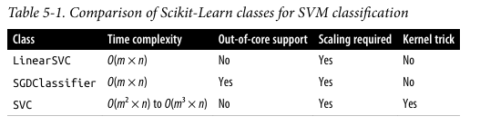
Computational Complexity
The LinearSVC class is based on the liblinear library, which implements an optimized algorithm for linear SVMs
The SVC class is based on the libsvm library, which implements an algorithm that supports the kernel trick. The training time complexity is usually between O(m2 × n) and O(m3 × n)
Notes:
After consulting a variety of sources, you will need to narrow your topic. For example, the topic of internet safety is huge, but you could narrow that topic to include internet safety in regards to social media apps that teenagers are using heavily. A topic like that is more specific and will be relevant to your peers. Some questions to think about to help you narrow your topic:
What topics of the research interest me the most?
What topics of the research will interest my audience the most?
What topics will the audience find more engaging? Shocking? Inspiring?

Slide 26
SVM Regression
As mentioned earlier, the SVM algorithm is versatile: not only does it support linear and nonlinear classification,
But it also supports linear and nonlinear regression.
To use SVMs for regression instead of classification, the trick is to reverse the objective: instead of trying to fit the largest possible street between two classes while limiting margin violations.
SVM Regression tries to fit as many instances as possible on the street while limiting margin violations (i.e., instances off the street). The width of the street is controlled by a hyperparameter
Notes:
Now, that you have narrowed your topic, you will want to organize your research in a structure that works. There are some common organizational patterns based on the kind of research you are doing.
Organizational Structures:
Cause and Effect- this kind of structure is great for explaining the causes and effects of a topic
Compare and Contrast- in this pattern you highlight the similarities and differences of the topic
Explain process- this structure is great for outlining a series of steps to follow;
Definition- if you want to make sure your audience understands what something is using illustrations, meanings, clarifying misconceptions, you may want to use this structure
Classification- a common organizational structure is grouping like topics or facts from the research together. For instance, in the internet safety about social media apps, you may organize the research where you look at each social media app one at a time

Slide 27
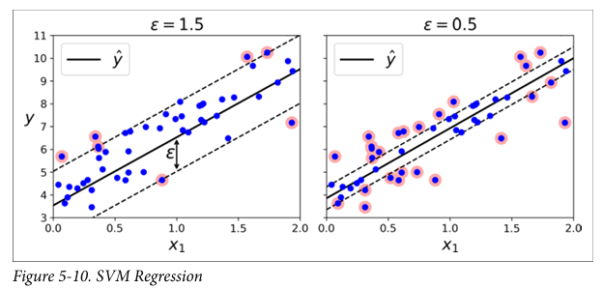
SVM Regression
Figure shows two linear Regression models trained on some random linear data, one with a large margin (ϵ = 1.5) and the other with a small margin (ϵ = 0.5):
Notes:
Now, that you have narrowed your topic, you will want to organize your research in a structure that works. There are some common organizational patterns based on the kind of research you are doing.
Organizational Structures:
Cause and Effect- this kind of structure is great for explaining the causes and effects of a topic
Compare and Contrast- in this pattern you highlight the similarities and differences of the topic
Explain process- this structure is great for outlining a series of steps to follow;
Definition- if you want to make sure your audience understands what something is using illustrations, meanings, clarifying misconceptions, you may want to use this structure
Classification- a common organizational structure is grouping like topics or facts from the research together. For instance, in the internet safety about social media apps, you may organize the research where you look at each social media app one at a time

Slide 28

SVM Regression
You can use Scikit-Learn’s LinearSVR class to perform linear SVM Regression.
The following code produces the model represented on the left in Figure previously shared (the training data should be scaled and centered first)
Notes:
Now, that you have narrowed your topic, you will want to organize your research in a structure that works. There are some common organizational patterns based on the kind of research you are doing.
Organizational Structures:
Cause and Effect- this kind of structure is great for explaining the causes and effects of a topic
Compare and Contrast- in this pattern you highlight the similarities and differences of the topic
Explain process- this structure is great for outlining a series of steps to follow;
Definition- if you want to make sure your audience understands what something is using illustrations, meanings, clarifying misconceptions, you may want to use this structure
Classification- a common organizational structure is grouping like topics or facts from the research together. For instance, in the internet safety about social media apps, you may organize the research where you look at each social media app one at a time

Slide 29
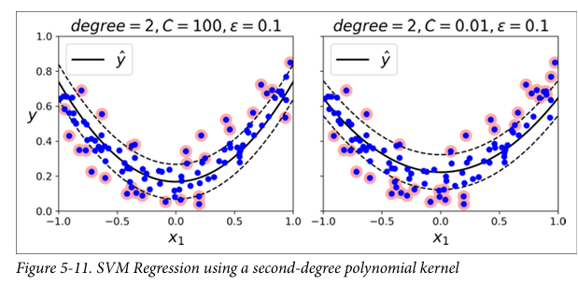
SVM Regression
To tackle nonlinear regression tasks, you can use a kernelized SVM model
There is little regularization in the left plot (i.e., a large C value)
Much more regularization in the right plot (i.e. a small C value).
Notes:
Now, that you have narrowed your topic, you will want to organize your research in a structure that works. There are some common organizational patterns based on the kind of research you are doing.
Organizational Structures:
Cause and Effect- this kind of structure is great for explaining the causes and effects of a topic
Compare and Contrast- in this pattern you highlight the similarities and differences of the topic
Explain process- this structure is great for outlining a series of steps to follow;
Definition- if you want to make sure your audience understands what something is using illustrations, meanings, clarifying misconceptions, you may want to use this structure
Classification- a common organizational structure is grouping like topics or facts from the research together. For instance, in the internet safety about social media apps, you may organize the research where you look at each social media app one at a time

Slide 30

SVM Regression
The following code uses Scikit-Learn’s SVR class (which supports the kernel trick) to
produce the model represented on the left in Figure previously shared.
The SVR class is the regression equivalent of the SVC class, and the LinearSVR class is the regression equivalent of the LinearSVC class.
The LinearSVR class scales linearly with the size of the training set (just like the LinearSVC class), while the SVR class gets much too slow when the training set grows large (just like the SVC class)
Notes:
Now, that you have narrowed your topic, you will want to organize your research in a structure that works. There are some common organizational patterns based on the kind of research you are doing.
Organizational Structures:
Cause and Effect- this kind of structure is great for explaining the causes and effects of a topic
Compare and Contrast- in this pattern you highlight the similarities and differences of the topic
Explain process- this structure is great for outlining a series of steps to follow;
Definition- if you want to make sure your audience understands what something is using illustrations, meanings, clarifying misconceptions, you may want to use this structure
Classification- a common organizational structure is grouping like topics or facts from the research together. For instance, in the internet safety about social media apps, you may organize the research where you look at each social media app one at a time

Slide 31
Exercises
What is the fundamental idea behind Support Vector Machines?
Support Vector Machines aim to find the optimal hyperplane that maximizes the margin between different classes in a dataset. This margin is the distance between the hyperplane and the closest data points from each class, called support vectors.
2. What is a support vector?
3. Why is it important to scale the inputs when using SVMs?
4. Can an SVM classifier output a confidence score when it classifies an instance?
What about a probability?
5. Should you use the primal or the dual form of the SVM problem to train a model
on a training set with millions of instances and hundreds of features?
6. Say you’ve trained an SVM classifier with an RBF kernel, but it seems to underfit
the training set. Should you increase or decrease γ (gamma)? What about C?
Notes:
After you’ve done your research, it’s time to put your presentation together. The first step in the process is to introduce the topic. This is a great time to connect your topic to something that your audience can relate. In other words, why should they listen to all the information you will be sharing in your research presentation? What is in it for them? You may also want to include a graphic or image to grab their attention.
Feel free to duplicate this slide by right-clicking on this slide in the slides pane to the left and select Duplicate Slide.
The next step in your presentation is to state your claim or topic clearly. Your teacher may even call this your thesis. As you state your thesis, you may find that this layout is not the best layout for your claim or topic. You can change the layout by clicking the drop-down menu next to the Layout in the Slides menu section. You can choose Two Content, Comparison, or Picture with Caption. Note: A different layout might change the look of the icons on this page.
You will also want to state your facts. You have done the research now share some of the interesting facts with your audience. Facts do not have to be boring; you can communicate facts in a variety of ways by going to the Insert Tab. In the Insert tab you can:
Insert pictures from your computer or online.
Add a chart
Create some SmartArt
Insert a variety of icons to help your facts come to life. Note: You can change the color of the icons by selecting the icon and then click on the Format tab and then Graphics Fill. From there, you will choose a color from the list or choose More Fill Colors to give you more options.
Since this research presentation is a result of your hard work and searching, you want to make sure you support the claims or points in your presentation with facts from your research findings. Make sure you give the author proper credit for helping you share your ideas. If one of your sources has a video that is relevant to your topic, you can add the video as added support. Keep in mind the length of the video and the amount of time you have for your presentation. For a 5 minute speech, the video should be no longer than 30 seconds.
Questions to consider:
How will you state the author of the source?
Will you need to cite the source on the slide?
What are some ways you can engage your audience so they feel like they are a part of the presentation? Some ideas to consider is by taking a quick poll like: by a show of hands, how many of you think school uniforms are a way to cut down on bullying? Another suggestion is to have them hold up a certain number of fingers to see if they agree or disagree. Finally, you can share a story that the audience can relate to that makes them laugh.
After all the applause, your audience may have some questions. Be prepared to answer some of their questions by making a list of questions you think they might ask. You may also want to share the presentation with them by providing the link to your presentation, if they want more information.

Slide 32
Exercises
7. How should you set the QP parameters (H, f, A, and b) to solve the soft margin
linear SVM classifier problem using an off-the-shelf QP solver?
8. Train a LinearSVC on a linearly separable dataset. Then train an SVC and a
SGDClassifier on the same dataset. See if you can get them to produce roughly
the same model.
9. Train an SVM classifier on the MNIST dataset. Since SVM classifiers are binary
classifiers, you will need to use one-versus-the-rest to classify all 10 digits. You
may want to tune the hyperparameters using small validation sets to speed up the
process. What accuracy can you reach?
10. Train an SVM regressor on the California housing dataset.
Notes:
After you’ve done your research, it’s time to put your presentation together. The first step in the process is to introduce the topic. This is a great time to connect your topic to something that your audience can relate. In other words, why should they listen to all the information you will be sharing in your research presentation? What is in it for them? You may also want to include a graphic or image to grab their attention.
Feel free to duplicate this slide by right-clicking on this slide in the slides pane to the left and select Duplicate Slide.
The next step in your presentation is to state your claim or topic clearly. Your teacher may even call this your thesis. As you state your thesis, you may find that this layout is not the best layout for your claim or topic. You can change the layout by clicking the drop-down menu next to the Layout in the Slides menu section. You can choose Two Content, Comparison, or Picture with Caption. Note: A different layout might change the look of the icons on this page.
You will also want to state your facts. You have done the research now share some of the interesting facts with your audience. Facts do not have to be boring; you can communicate facts in a variety of ways by going to the Insert Tab. In the Insert tab you can:
Insert pictures from your computer or online.
Add a chart
Create some SmartArt
Insert a variety of icons to help your facts come to life. Note: You can change the color of the icons by selecting the icon and then click on the Format tab and then Graphics Fill. From there, you will choose a color from the list or choose More Fill Colors to give you more options.
Since this research presentation is a result of your hard work and searching, you want to make sure you support the claims or points in your presentation with facts from your research findings. Make sure you give the author proper credit for helping you share your ideas. If one of your sources has a video that is relevant to your topic, you can add the video as added support. Keep in mind the length of the video and the amount of time you have for your presentation. For a 5 minute speech, the video should be no longer than 30 seconds.
Questions to consider:
How will you state the author of the source?
Will you need to cite the source on the slide?
What are some ways you can engage your audience so they feel like they are a part of the presentation? Some ideas to consider is by taking a quick poll like: by a show of hands, how many of you think school uniforms are a way to cut down on bullying? Another suggestion is to have them hold up a certain number of fingers to see if they agree or disagree. Finally, you can share a story that the audience can relate to that makes them laugh.
After all the applause, your audience may have some questions. Be prepared to answer some of their questions by making a list of questions you think they might ask. You may also want to share the presentation with them by providing the link to your presentation, if they want more information.

Slide 33
MACHINE LEARNING
Chapter 5: Support Vector Machines
Notes:
You can use this slide as your opening or closing slide. Should you choose to use it as a closing, make sure you review the main points of your presentation. One creative way to do that is by adding animations to the various graphics on a slide. This slide has 4 different graphics, and, when you view the slideshow, you will see that you can click to reveal the next graphic. Similarly, as you review the main topics in your presentation, you may want each point to show up when you are addressing that topic.
Add animation to images and graphics:
Select your image or graphic.
Click on the Animations tab.
Choose from the options. The animation for this slide is “Split”. The drop-down menu in the Animation section gives even more animations you can use.
If you have multiple graphics or images, you will see a number appear next to it that notes the order of the animations.
Note: You will want to choose the animations carefully. You do not want to make your audience dizzy from your presentation.

